Slide 1
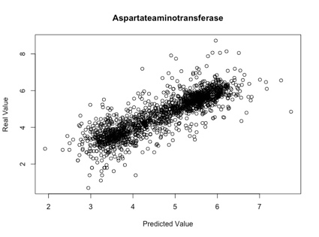
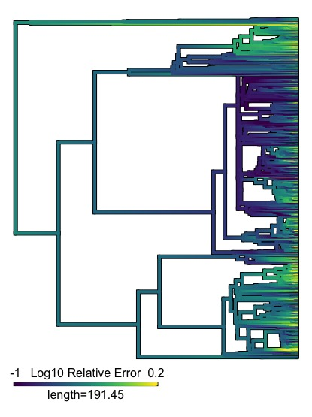
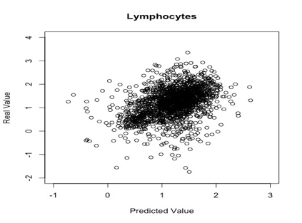
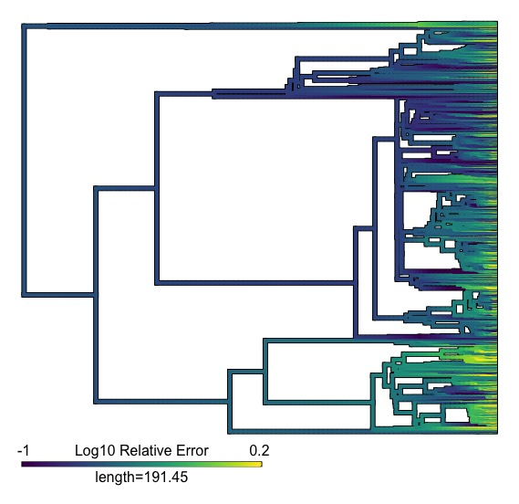
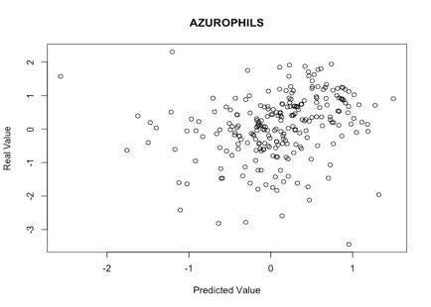
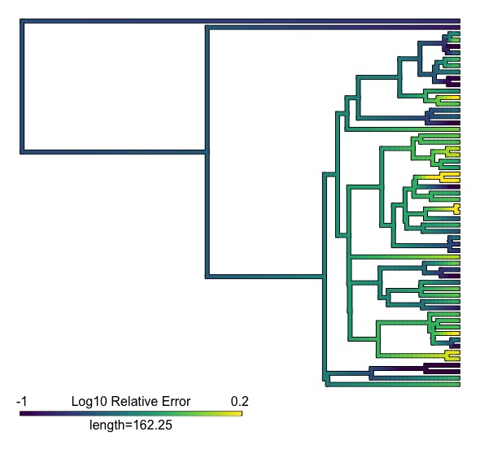
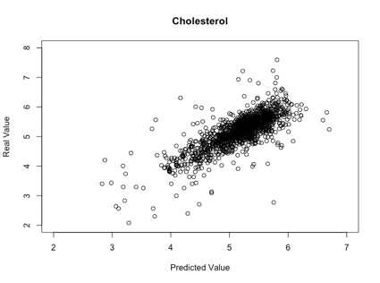
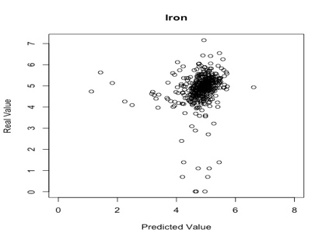
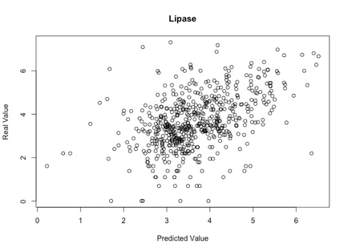
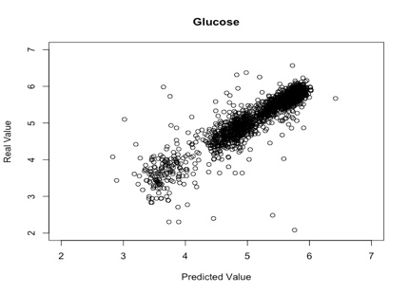
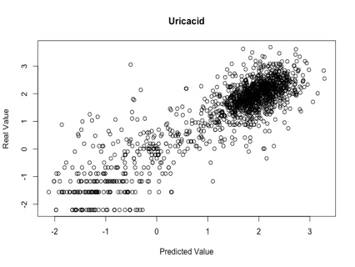
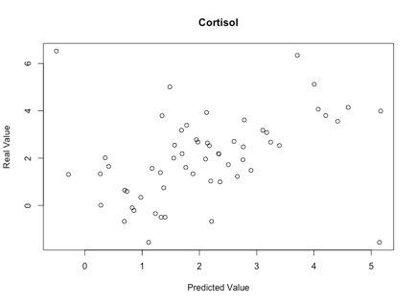
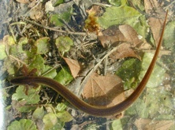
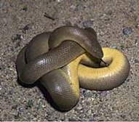
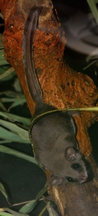
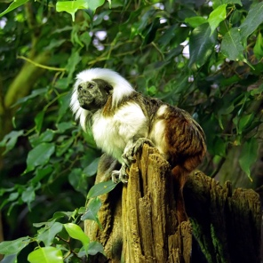
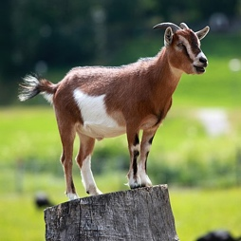
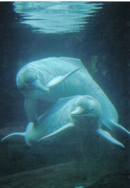
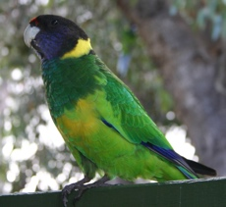
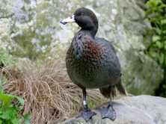
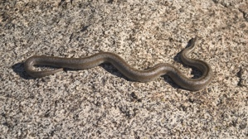
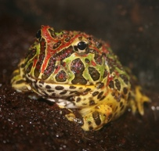
Predicting Baseline Physiological Trait Values for Data Deficient Species Using Evolutionary Models
Brian K. Yoon
Josef C. Uyeda
Department of Biological Sciences
Goal: Create a predictive evolutionary model that utilizes preexisting physiological trait data of all species to make reasonable deductions for those species whose individual traits lack accurate information.
Phylogenetic data used in this program was sourced from Treeplyer, a database of 86 animal blood test traits and other physical evaluations. Data was run through a Brownian Motion program, which was then cross validated for accuracy.
Subset of glucose data showing predicted distribution vs. actual value for select species.
ContMap for Glucose Data
ContMap for Uric Acid Data
ContMap for Cortisol Data
Example Species exhibiting outlier values for glucose
Feathertail glider
Amazon river dolphin
Example Species exhibiting outlier values for Uric Acid
Cottontop Tamarin
Example Species exhibiting outlier values for glucose
Blue Duck
Rosy Boa
Australian Ringneck
Argentine Horned Frog
Southern Dwarf Siren
Rubber Boa
Domestic Goat
Results showed several traits that were highly predictable due to their phylogenetically-conserved nature, while others traits yielded predictions that were distant from their actual values and indicated very little phylogenetic signal for these traits. For some traits, we found evidence of poor predictions in certain groups of organisms, indicating that the evolutionary process has changed in these groups. Other predictions suggest errors in the database due to faulty data collection. Our analysis helps determine which traits are evolutionarily predictable, and which were too noisy to confidently predict. Continued refinement of the model is in order to enable practical use of species trait predictions, as well as possible medical and veterinary usage for poorly studied and understood species.
References:
All other photos uploaded by Wikipedia/sourced from Public Domain
Amazon River Dolphin:
By Stefanie Triltsch (de:Benutzer:Nixvonliebe) - Own work, CC BY-SA 2.5, https://commons.wikimedia.org/w/index.php?curid=1973156
Argentine Horned Frog:
By Melanie Mae Bryan from Greensboro, NC, USA - [1], CC BY 2.0, https://commons.wikimedia.org/w/index.php?curid=3376971
Australian Ringneck:
By Tirin, www.takver.com
Cottontop Tamarin:
By © Raimond Spekking / CC BY-SA 4.0 (via Wikimedia Commons), CC BY-SA 4.0, https://commons.wikimedia.org/w/index.php?curid=92062
Domestic Goat:
By Kuebi = Armin Kübelbeck - Own work, CC BY-SA 3.0, https://commons.wikimedia.org/w/index.php?curid=10972619
Elephas maximus (phylopic):
T. Michael Keesey
http://creativecommons.org/licenses/by/3.0/
Feathertail Glider:
By Elias Neideck - Own work, CC BY-SA 3.0, https://commons.wikimedia.org/w/index.php?curid=20000755
Rosy Boa:
CC BY-SA 2.5, https://en.wikipedia.org/w/index.php?curid=3260936
Scopus umbrette:
Arthur Grosset (photo), John E. McCormack, Michael G. Harvey, Brant C. Faircloth, Nicholas G. Crawford, Travis C. Glenn, Robb T. Brumfield & T.
Michael Keesey
http://creativecommons.org/licenses/by/3.0/

